Slide 1
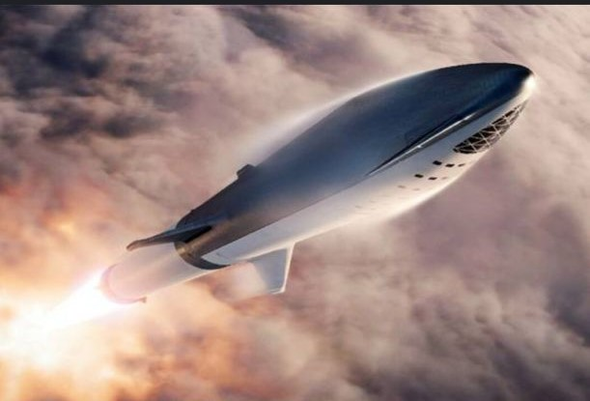
IBA DATA SCIENCE CAPSTONE PROJECT
SHAEMA KHAN
22 JUNE 2025

Slide 2


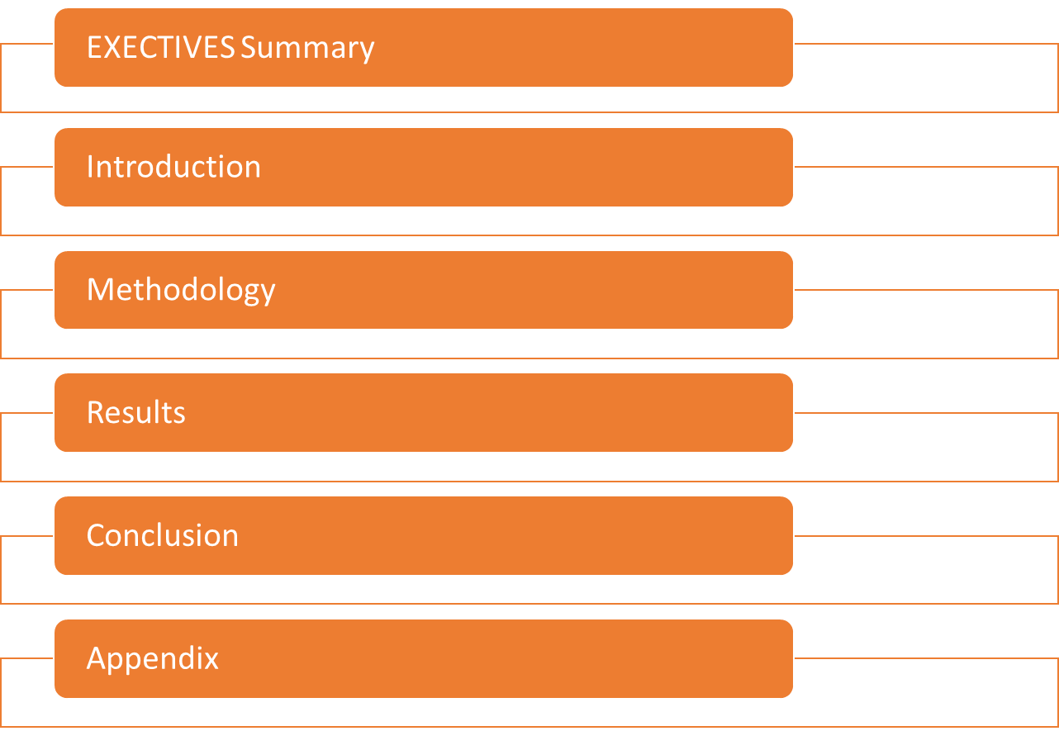
OUTLINE

Slide 3
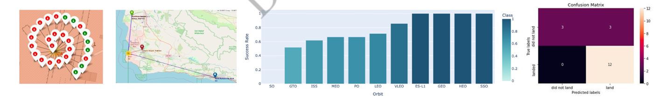
Executive Summary
SUMMARY OF METHODOLOGIES
Data collection via API , SQL and Web Scraping
Data Wrangling and Analysis
Interactive Maps with Folium
Predictive Analysis for each classification model
Summary of all results –
Data Analysis along with Interactive Visualizations
Best model for Predictive Analysis

Slide 4


Introduction
Project background and context:
Here we will predict if the falcon 9 first stage will land successfully . SpaceX advertise falcon 9 rocket launches on its website , with a cost of 62 million dollars ; other providers cost upward of 165 million dollars each , much of the savings is because of SpaceX can reuse the first stage . Therefore , if we can determine if the first stage will land successfully . This information can be used if an alternate company wants to bid against SpaceX for a rocket launch
Problems we want to find answer
With what factors , the rocket will land successfully ?
The effect of each relationship of rocket variables on outcome.
Conditions which will aid SpaceX have to achieve the best results.

Slide 5
Methodology
Data collection methodology:
Via SpaceX Rest API
Web Scrapping from Wikipedia
Perform data wrangling:
One hot encoding data fields for machine learning and dropping irrelevant columns (Transforming data for Machine Learning)
Perform exploratory data analysis (EDA) using visualization and SQL:
Scatter and bar graphs to show patterns between data
Perform interactive visual analytics:
Using Folium and Plotly Dash Visualizations
Perform predictive analysis using classification models:
Build and evaluate classification models

Slide 6
Methodology

Slide 7
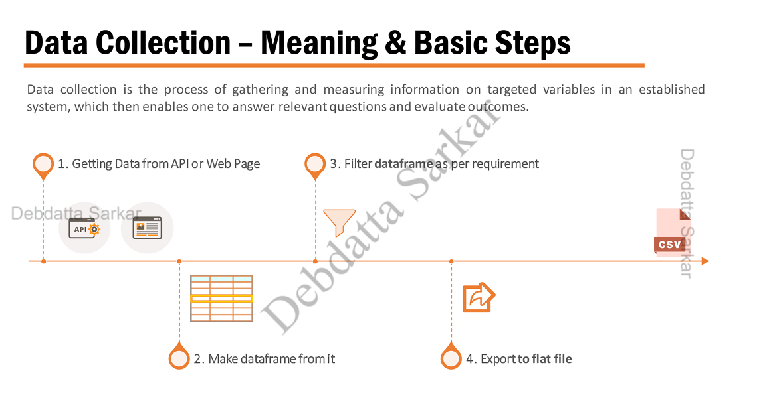



































Data Collection – Meaning & Basic Steps
Data collection is the process of gathering and measuring information on targeted variables in an established system, which then enables one to answer relevant questions and evaluate outcome .
3. Filter data frame as per requirement

Slide 8
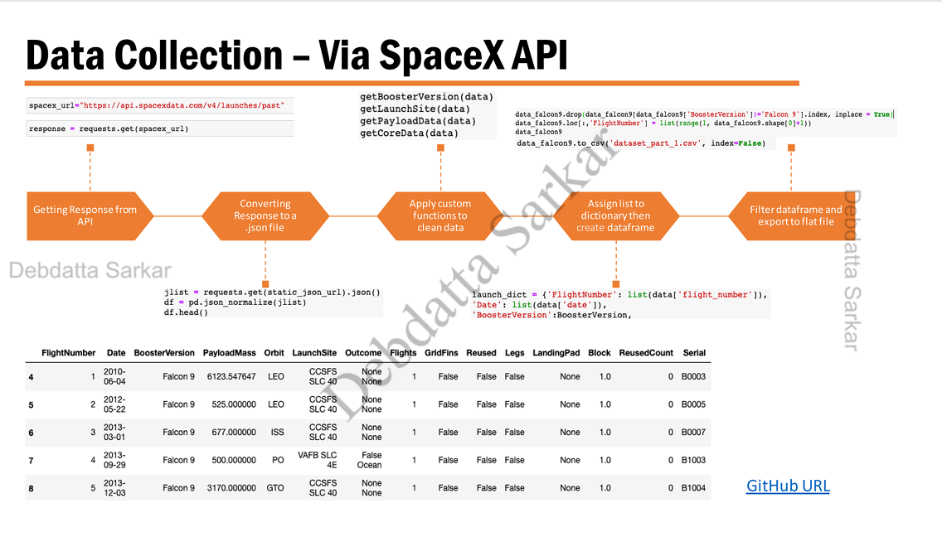


Data Collection – Via SpaceX API
data falcony.drop data falcony data falcons BoosterVersion | Falcos index, inplace Tru
spacex url="https://api.spacexdata.com/v4/launches/past"
get.BoosterVersion(data)
getLaunchSite(data)
getPayloadData(data)
getCoreData(data)
response requests.get(spacex_url)
date falcony.loci, Flighthunber') list(range(i, data falcony.shape(0)+11)
data falcong
data falcon9.to cav( dataset part 1.csv',
index-False)
jlist
requests.get(static json url).jaon()
df pd.json_normalize(jlist)
df.head()
Taunch dict{'FlightNumber': list(data['flight number"]},
'Date': list(data['date')),
Booster Version :BoosterVersion,
GitHub URL
Flight Number | Date | Booster Version | Payload Mass | Orbit | Launch Site | Outcome
4 | 1 2010 06-04 | Falcon 9 | 6123.547647 | None None | 1 | False
5 | 2 2012 05-22 | Falcon 9 | 525.000000 | None None | 1 | False
6 | 3 2013 03-01 | Falcon 9 | 677.000000 | False Ocean | 1 | False
7 | 4 2013 09-29 | Falcon 9 | 500.000000 | None None | 1 | False
8 | 5 2013 12-03 | Falcon 9 | 3170.000000 | None None | 1 | False
Flights | Grid Fins | Reused | Legs | Landing Pad | Block | Reused Count | Serial
1 | False | False | False | None | 1.0 | 0 | B0003
1 | False | False | False | None | 1.0 | 0 | B0003
1 | False | False | False | None | 1.0 | 0 | B0003
1 | False | False | False | None | 1.0 | 0 | B0003
1 | False | False | False | None | 1.0 | 0 | B0003

Slide 9
Data Collection – Via Web Scraping
Creating BeautifulSoup Object
Finding tables
Creation of dictionary and appending data to keys
Converting dictionary to dataframeConverting dictionary to dataframe
Getting Response from HTML
Getting column names
Dataframe to .CSV
static url "https://en.wikipedia.org/w/index.php?title-List_of_Faicos_9_and_Faloon jeavy Launchesiodid-1027686922"
data requests.get(static_url).toxt
soup BeautifulSoup(data, html5lib')
html tables soup.find_all("table") first launch table html_tables[21
This = first_launch_table.find_all(‘th’)
For th in this :
name = extract_column_from_header(th)
If name is not None and len ( name) >0:
column_name.append(name)
Launch_dict=dict.fromkeys(column_names)
 | Flight No | Launch site | Payload | Payload Mass | Orbit | Customer
0 | 1 | CGAFS | Dragon Spacecraft Qualification Unit | 0 | LEO | SpaceX
1 | 2 | CGAFS | Dragon | 0 | LEO | NASA
2 | 3 | CGAFS | Dragon | 525 kg | LEO | NASA
3 | 4 | CGAFS | SpaceX CRS-1 | 4,700 kg | LEO | NASA
4 | 5 | CGAFS | SpaceX CRS-2 | 4,877 kg | LEO | NASA
Launch outcome | Version Booster | Booster landing | Date | Time
Success | F9 v1.080003.1 | Failure | 4 June 2010 | 18:45
Success | F9 v1.080004,1 | Failure | 8 December 2010 | 15:43
Success | Fil v1.080005.1 | No attempt | 22 May 2012 | 07:44
Success | F9 v1.080006.1 | No attempt | 8 October 2012 | 00:35
Success | F9 v1.080007.1 | No attempt | 1 March 2013 | 15:10

Slide 10
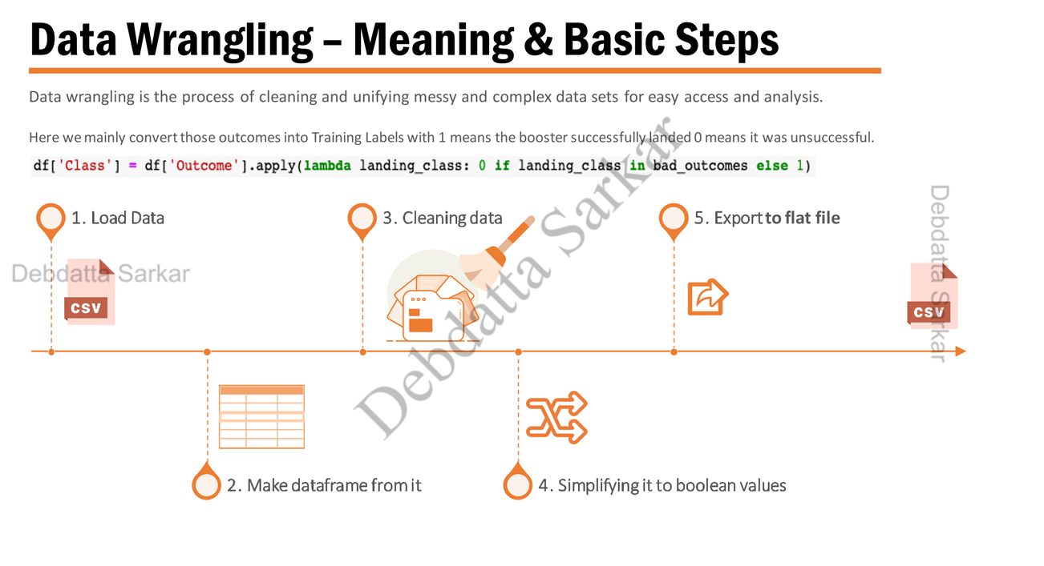







Data Wrangling – Meaning & Basic Steps
Data wrangling is the process of cleaning and unifying messy and complex data sets for easy access and analysis.
Here we mainly convert those outcomes into Training Labels with 1 means the booster successfully landed 0 means it was unsuccessful.
df['Class'] = df['Outcome'].apply(lambda landing_class: 0 if landing_class in bad_outcomes else 1)

Slide 11
Data Wrangling
df['Class'] df Outcome').apply(la landing classsit landing class is bad outcomes elsa 11
df(Clans 11.head(8)
Calculate number of launches at each site
Calculate number and occurrence of each orbit
Calculate number and occurrence of mission outcome per orbit type
dff 'LaunchSite"].value_counts()
CCAFS SLC 40
55
KSC LC 39A
22
VAFB SLC 48 13
Create landing outcome label from Outcome column
Export dataset as CSV
df['Orbit'].value_counts ()
GTO 27
ISS 21
VLEO 14
PC 9
LEO 7
SSO 5
MEO 3
ES-LI 1
HEO 1
SO 1
GEO 1
df.to cay("cava/dataset_part 2.csv", index False)
GitHub URL
Flight Number | Date | Booster Version | Payload Mass | Orbit | Launch Site | Outcome
0 | 1 2010 06-04 | Falcon 9 | 6123.547647 | LEO | CCAFS SLC-40 | False
1 | 2 2012 05-22 | Falcon 9 | 525.000000 | LEO | CCAFS SLC 40 | False
2 | 3 2013 03-01 | Falcon 9 | 677.000000 | ISS | CCAFS SLC-40 | False
3 | 4 2013 09-29 | Falcon 9 | 500.000000 | PO | VAFB SLC 4E | False Ocean
4 | 5 2013 12-03 | Falcon 9 | 3170.000000 | GTO | CCAFS SLC 40 | False
Flights | Grid Fins | Reused | Legs | Landing Pad | Block | Reused Count | Serial
1 | False | False | False | NaN | 1.0 | 0 | B0003
1 | False | False | False | NaN | 1.0 | 0 | B0005
1 | False | False | False | NaN | 1.0 | 0 | B0007
1 | False | False | False | NaN | 1.0 | 0 | B1003
1 | False | False | False | NaN | 1.0 | 0 | B10004
landing_outcomes = df[Outcome').value_counts()
True ASDS 41
None None 19
True RTLS 14
False ASDS 6
True Ocean 5
None ASDS 2
False Ocean 2
False RTLS 1

Slide 12
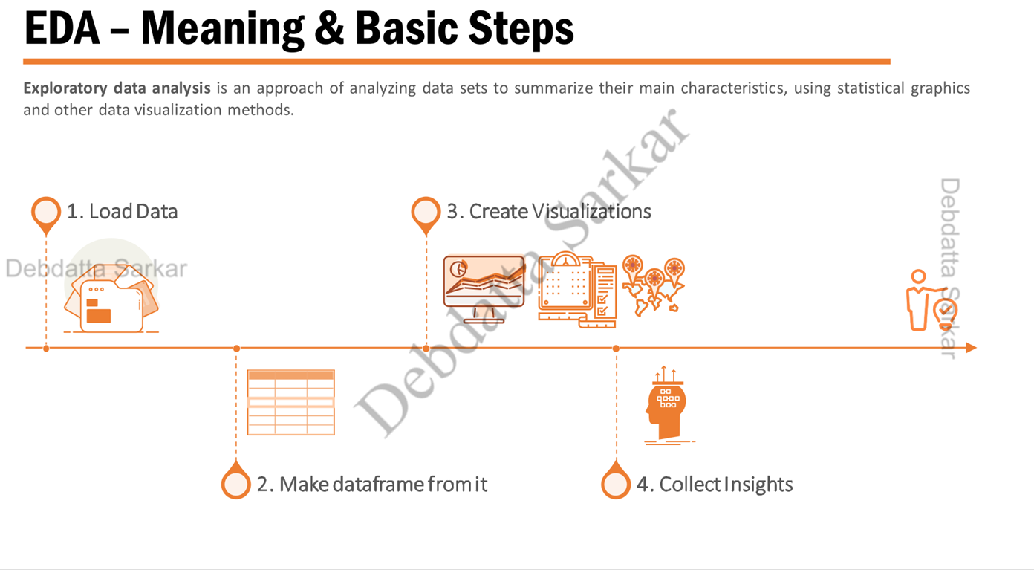






EDA - Meaning & Basic Steps
Exploratory data analysis is an approach of analyzing data sets to summarize their main characteristics, using statistical graphics and other data visualization methods.
3. Create Visualizations

Slide 13
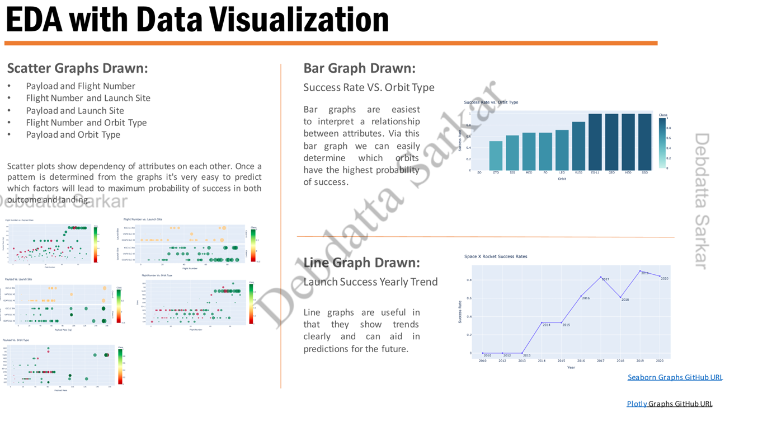
EDA with Data Visualization
Scatter Graphs Drawn:
Payload and Flight Number
Flight Number and Launch Site
Payload and Launch Site
Flight Number and Orbit Type
Payload and Orbit Type
Bar Graph Drawn:
Success Rate VS. Orbit Type
Bar graphs are easiest to interpret a relationship between attributes. Via this bar graph we can easily determine which have the highest probability of success.
Scatter plots show dependency of attributes on each other. Once a pattem is determined from the graphs it's very easy to predict which factors will lead to maximum probability of success in both
outcome and landingarkar
Line Graph Drawn:
aunch Success Yearly Trend
Line graphs are useful in that they show trends clearly and can aid in predictions for the future.
Seaborn Graphs GitHub URL
Plotly Graphs GitHub

Slide 14

EDA with SQL
SQL is an indispensable tool for Data Scientists and analysts as most of the real-world data is stored in databases. It's not only the standard language for Relational Database operations, but also an incredibly powerful tool for analyzing data and drawing useful insights from it. Here we use IBM's Db2 for Cloud, which is a fully managed SQL Database provided as a service.
pip install sqlalchemy =1.3.9
Ipip install ibm_db_sa
Ipip install ipython-sql
%load ext sql
%sqlibm_db_sa://my-username:my-password @my-hostname:my-port/my-db-name
%sql <your query>
We performed sat queries to gather information from given dataset :
Displaying the names of the unique launch sites in the space mission.
Display 5 records where launch sites begin with the string 'CCA'
Displaying the total payload mass carried by boosters launched by NASA (CRS
Displaying average payload mass carried by booster version F9v1.1
Listing the date where the successful landing outcome in drone ship was achieved
Listing the names of the boosters which have success in ground pad and have payload mass greater than 4000 but less than 6000
Listing the total number of successful and failure mission outcomes
Listing the names of the booster_versions which have carried the maximum payload mass
Listing the failed landing_outcomes in drone ship, their booster versions, and launch site names for the year 2015
Ranking the count of landing outcomes (such as Failure (drone ship) or Success (ground pad)) between the date 2010-06-04 and 2017-03-20, in descending order

Slide 15

Build an Interactive Map with Folium
Folium makes it easy to visualize data that's been manipulated in Python on an interactive leaflet map. We use the latitude and longitude coordinates for each launch site and added a Circle Marker around each launch site with a label of the name of the launch site. It is also easy to visualize the number of success and failure for each launch site with Green and Red markers on the map
Map Objects | Code | Result
Map Marker | folium.Marker( | Map object to make a mark on map.
Icon Marker | folium.Icon( | Create an icon on map.
Circle Marker | folium.Circle( | Create a circle where Marker is being placed.
PolyLine | folium.PolyLine( | Create a line between points
Marker Cluster Object | MarkerCluster( | This is a good way to simplify a map containing many markers having the same coordinate
AntPath | folium.plugins.AntPath( | Create an animated line between points
Original Project - GitHub URL
Clean Distance Markers GitHub URL

Slide 16
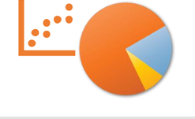
Build a Dashboard with Plotly Dash
Pie Chart showing the total success for all sites or by certain launch site
Percentage of success in relation to launch site
Scatter Graph showing the correlation between Payload and Success for all sites or by certain launch site
It shows the relationship between Success rate and Booster Version Category
Map Objects | Code | Result
Dash and its components | import dash_html_components as html import dash_core_components as dcc from dash.dependencies import Input, Output | Plotly stewards Python's leading data viz and Ul libraries. With Dash Open Source, Dash apps run on your local laptop or server. The Dash Core Component library contains a set of higher-level components like sliders, graphs, dropdowns, tables, and more. Dash provides all of the available HTML tags as user-friendly Python classes.
Pandas | import pandas as pd | Fetching values from CSV and creating a dateframe
Plotly | import plotly.express as px | Plot the graphs with interactive plotly library
Dropdown | dcc.Dropdown | Create a dropdown for launch sites
Rangeslider | dcc.RangeSlider( | Create a rangeslider for Payload Mass range selection
Pie Chart | px.pie( | Creating the Pie graph for Success percentage display
Scatter Chart | px.scatter( | Creating the Scatter graph for correlation display
GitHub Code URL
Used "Python Anywhere" to host a live website. The live site dashboard is built with Flask and Dash.
Live Site URL

Slide 17
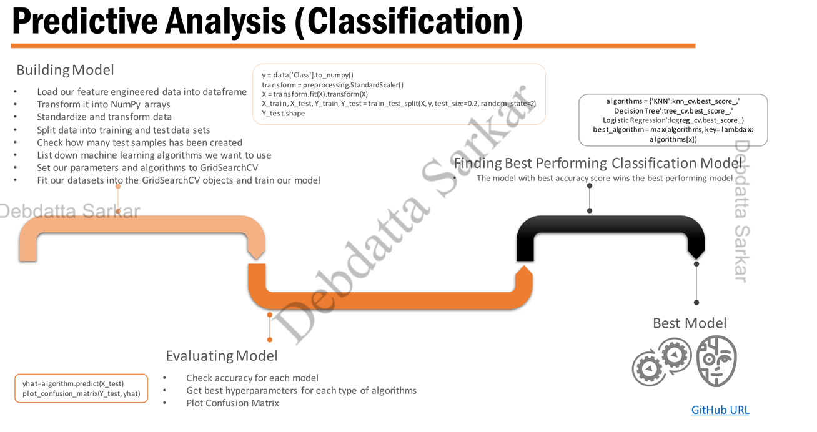













Predictive Analysis (Classification)
y data['Class10_numpy()
transform = preprocessing StandardScaler()
X=transform.fit(X).transform(X)
X train, X test, Ytrain, Y test train test split(X, y, test size 0.2,rando_state=2)
Y_test shape
Building Model
Load our feature engineered data into dataframe
Transform it into NumPy arrays
Standardize and transform data
Split data into training and test data sets
Check how many test samples has been created
List down machine learning algorithms we want to use
Set our parameters and algorithms to GridSearchCV
Fit our datasets into the GridSearchCV objects and train our model
algorithms ("KNN":knn_cv.best_score,
Decision Tree'stree_cv.best_score
Logistic Regression':logreg_cv.best_score_)
best algorithm=max(algorithms, keys lambda x:
algorithms[x])
Finding Best Performing Classification Model
The model with best accuracy score wins the best performing model

Slide 18

Results
Exploratory data analysis results
Interactive analytics demo in screenshots
Predictive analysis results

Slide 19

EDA with Visualization

Slide 20
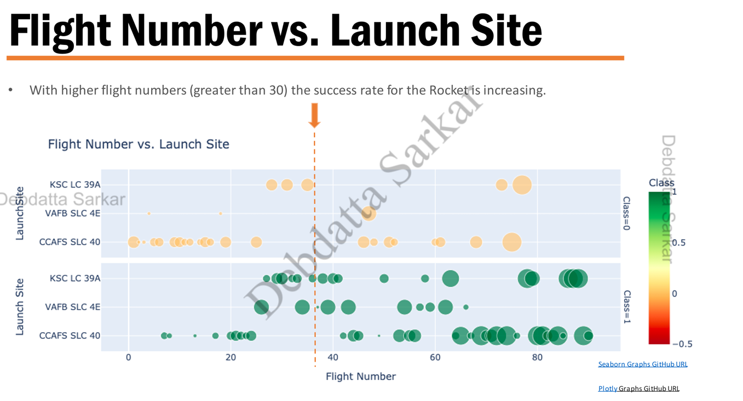



Flight Number vs. Launch Site
With higher flight numbers (greater than 30) the success rate for the Rocket is increasing
Flight Number vs. Launch Site
LaunchSite
Plotly Graphs GitHub

Slide 21
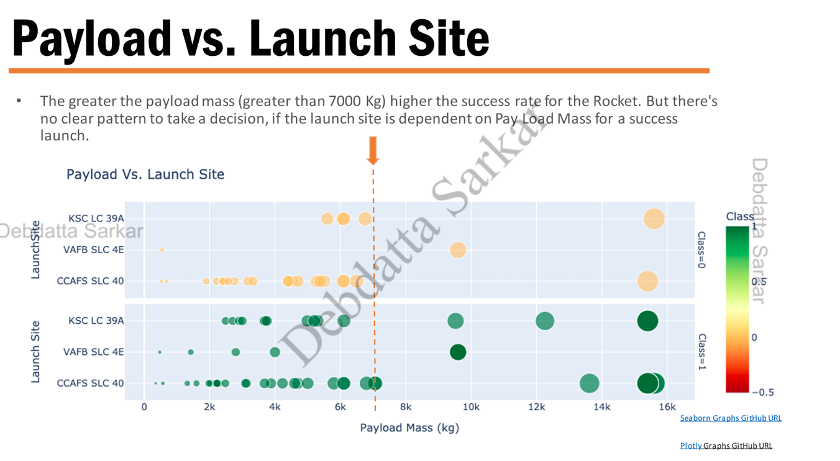


Payload vs. Launch Site
The greater the payload mass (greater than 7000 Kg) higher the success rate for the Rocket. But there's no clear pattern to take a decision, if the launch site is dependent on Pay Load Mass for a success launch.
LaunchSite
Payload Vs. Launch Site
0.5

Slide 22
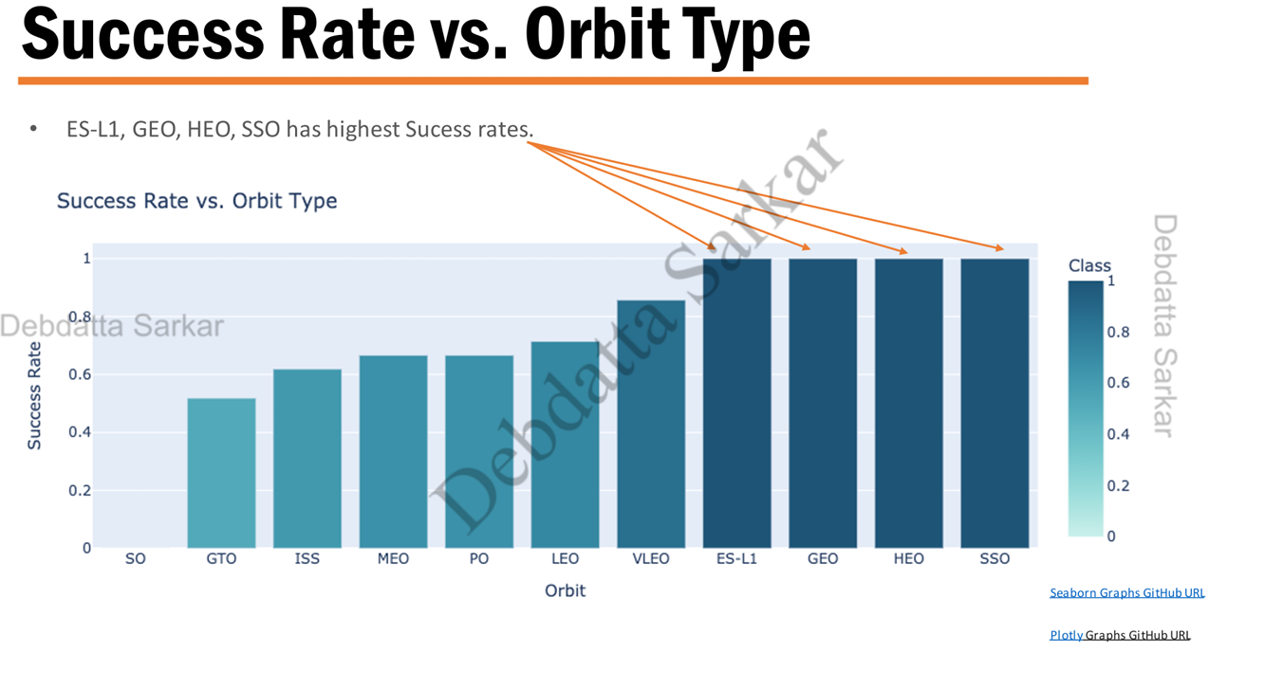




Success Rate vs. Orbit Type
ES-L1, GEO, HEO, SSO has highest Sucess rates.
Success Rate vs. Orbit Type
1
0.8
Success rate
Orbit
Seaborn Graphs GitHub URL
Plotly Graphs GitHub URL

Slide 23
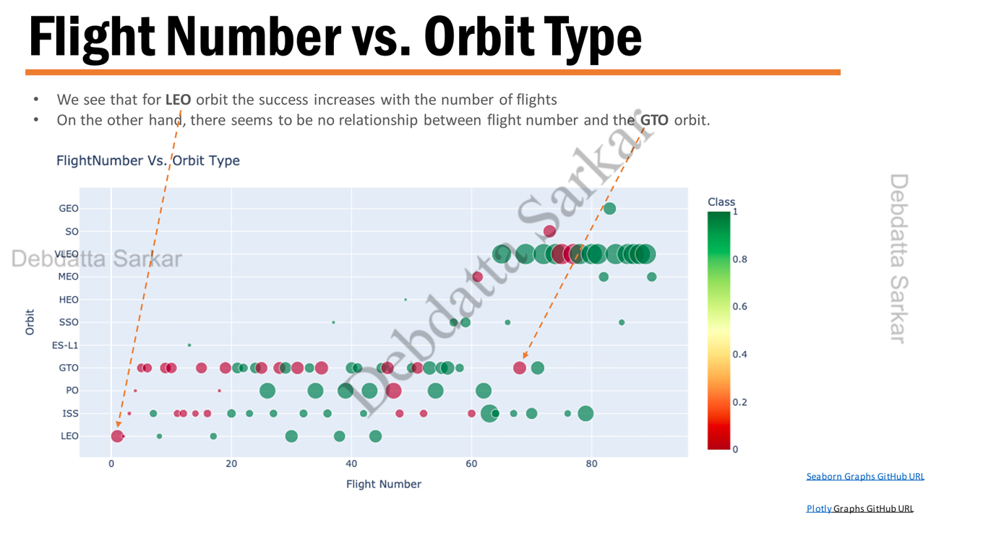

Flight Number vs. Orbit Type
We see that for LEO orbit the success increases with the number of flights
On the other hand, there seems to be no relationship between flight number and the GTO orbit.
FlightNumber Vs. Orbit Type
Orbit
Seaborn Graphs GitHub URL
Plotly Graphs GitHub URL

Slide 24
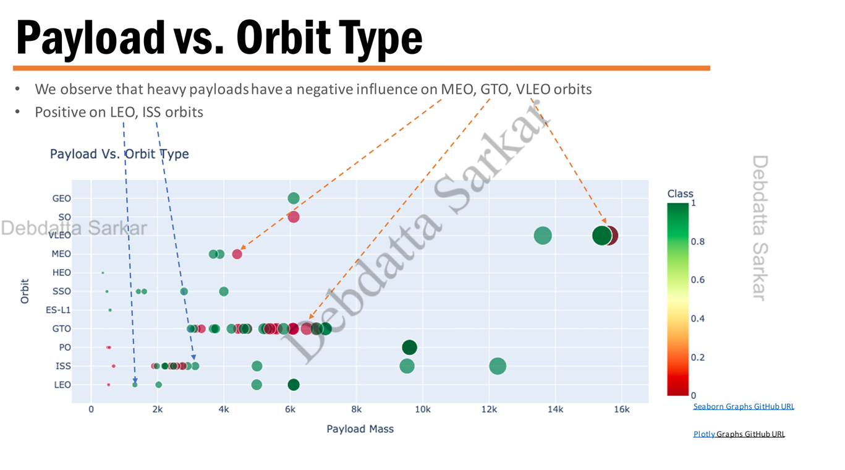




Payload vs. Orbit Type
We observe that heavy payloads have a negative influence on MEO, GTO, VLEO orbits
Positive on LEO, ISS orbits
Payload Vs. Orbit Type
Seaborn Graphs GitHub URL
Plotly Graphs GitHub URL

Slide 25
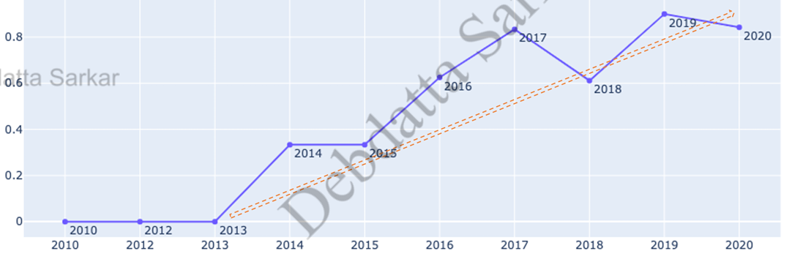
Launch Success Yearly Trend
We can observe that the sucess rate since 2013 kept increasing relatively though there is slight dip after 2019.
Space X Rocket Success Rates
Success rate
Years
Seaborn Graphs GitHub URL
Plotly Graphs GitHub URL

Slide 26

EDA with SQL

Slide 27
All Launch Site Names
SQL Query
%sql SELECT DISTINCT LAUNCH SITE as "Launch Sites" FROM SPACEX;
Description
Launch_Sites
CCAFS LC-40
CCAFS SLC-40
KSC LC-39A
VAFB SLC-4E
Using the word DISTINCT in the query we pull unique values for Launch_Site
column from table SPACEX

Slide 28
Launch Site Names begin with 'CCA'
SQL Query
sql SELECT FROM SPACEX WHERE LAUNCH SITE LIKE 'CCAS’ LIMIT 5;
Description
Using keyword 'LIMIT 5' in the query we fetch 5 records from table spacex and with condition LIKE keyword with wild card - 'CCA%'. The percentage in the end suggests that the Launch Site name must start with CCA
DATE | time utc | booster version | launch site | Payload | Paylond_mass_kg_ | orbit
2010-06-04 | 18:45:00 | F9 v1.0 80003 | CCAFS LC-40 | Dragon Spacecraft Qualification Unit | 0 | LEO
2010-12-08 | 15:43:00 | F9 v1.0 80004 | CCAFS LC-40 | Dragon demo flight C1, two CubeSats, barrel of Brouere cheese | 0 | LEO (ISS)
2012-05-22 | 07:44:00 | F9 v1.0 80005 | CCAFS LC-40 | Dragon demo flight C2 | 525 | LEO (ISS)
2012-10-08 | 00:35:00 | F9 v1.0 80006 | CCAFS LC-40 | SpaceX CRS-1 | 500 | LEO (ISS)
2013-03-01 | 15:10:00 | F9 v1.0 80007 | CCAFS LC-40 | SpaceX CRS-2 | 677 | LEO (ISS)
customer | mission_outcome | landing_outcome
SpaceX | Success | Failure (parachutej
NASA (COTS) NRO | Success | Failure (parachutej
NASA (COTS) | Success | No attempt
NASA (CRS) | Success | No attempt
NASA (CRS) | Success | No attempt

Slide 29
Total Payload Mass
SQL Query
%sql SELECT SUM(PAYLOAD_MASS_KG) AS "Total Payload Mass by NASA (CRS)”FROM SPACEX WHERE CUSTOMER 'NASA (CRS)';
Description
Using the function SUM calculates the total in the column PAYLOAD_MASS_KG_and WHERE clause filters the data to fetch Customer's by name "NASA (CRS)".
Total Payload Mass by NASA ( CRS) (CRS)
45596

Slide 30
Average Payload Mass by F9 v1.1
SQL Query
%sql SELECT AVG(PAYLOAD MASS KG) AS "Average Payload Mass by Booster Version F9 v1.1" FROM SPACEX WHERE BOOSTER_VERSION= 'F9 v1.1';
Description
Using the function AVG works out the average in column PAYLOAD_MASS_KG_
The WHERE clause filters the dataset to only perform calculations on Booster version "F9 v1.1".
Average Payload Mass by Booster Version F9 v1.1
2928

Slide 31
First Successful Ground Landing Date
SQL Query
% sql SELECT MIN(DATE) AS "First Succesful Landing Outcome in Ground Pad" FROM SPACEX WHERE LANDING OUTCOME = 'Success (ground pad)’;
Description
Using the function MIN works out the minimum data in the the column Date and WHERE clause filters the data to only perform calculations on Landing_Outcome with values "Success (ground pad
First Succesful Landing Outcome in Ground Pad
2015-12-22

Slide 32
Successful Drone Ship Landing with Payload between 4000 and 6000
SQL Query
%sql SELECT BOOSTER_VERSION FROM SPACEX WHERE LANDING OUTCOME AND PAYLOAD_MASS_KG > 4000 AND PAYLOAD_MASS_KG_ <600;
Description
Selecting only Booster_Version,
WHERE clause filters the dataset to Landing_Outcome = Success (drone ship)
booster_version
F9 FT B1022
F9 FT B1026
F9 FT B1021.2
F9 FT B1031.2
AND clause specifies additional filter conditions
Payload_MASS_KG_ > 4000 AND Payload_MASS_KG_< 6000

Slide 33
Total number of Successful and Failure Mission Outcomes
SQL Query
sql SELECT sum(case when MISSION_OUTCOME LIKE ‘%Success%’ then 1 else 0 end) AS "Successful Mission",
sum(case when MISSION_OUTCOME LIKE 'Failure then 1 else 0 end) AS "Failure Mission" \
FROM SPACEX;
Description
Selecting multiple count is a complex query. I have used case clause within sub query for getting both success and failure d failure counts in same query.
Successful Mission | Failure Mission
100 | 1
Case when MISSION OUTCOME LIKE '%Success%' then 1 else 0 end" returns a Boolean value which we sum to get the result needed.

Slide 34
Boosters carried Maximum Payload
SQL Query
%sql SELECT DISTINCT BOOSTER_VERSION AS "Booster Versions which carried the the Maximum Payload Mass" FROM SPACEX WHERE PAYLOAD_MASS_KG (SELECT MAX(PAYLOAD_MASS_KG) FROM SPACEX
Description
Booster Versions which carried the Maximum Payload
F9 B5 B1048.4
F9 B5 B1048.5
F9 B5 B1049.4
F9 B5 B1049.5
F9 B5 B1049.7
F9 B5 B1051.3
F9 B5 B1051.4
F9 B5 B1051.6
F9 B5 B1056.4
F9 B5 B1058.3
F9 B5 B1060.2
F9 B5 B1060.3
Using the function MAX works out the maximum payload in in the column PAYLOAD_MASS_KG_ in sub query
WHERE clause filters Booster Version which had that maximum payload

Slide 35
2015 Launch Records
SQL Query
sql SELECT (fn MONTHNAME (DATE)} as "Month", BOOSTER_VERSION, LAUNCH_SITE FROM SPACEX WHERE year(DATE) '2015' AND \ LANDING OUTCOME 'Failure (drone ship)';
Description
We need to list the records which will display month names, failure landing_outcomes in drone ship, booster versions, launch_site for the months in year 2015.
Month | booster_version | launch site
January | F9 v1.1 B1012 | CCAFS LC-40
April | F9 v1.1 B1015 | CCAFS LC-40
Via year function we extract the year and future where clause 'Failure (drone ship)' fetches our required values.
Also, am using {fn MONTHNAME(DATE)} to get the Month name.

Slide 36
Rank Landing Outcomes between 2010-06-04 and 2017-03-20
SQL Query
%sql SELECT LANDING OUTCOME as "Landing Outcome", COUNT (LANDIN OUTCOME) AS "Total Count" FROM SPACEX \
WHERE DATE BETWEEN 2010-06-04' AND '2017-03-20' \
GROUP BY LANDING OUTCOME \
ORDER BY COUNT(LANDING OUTCOME) DESC;
Description
Landing Outcome | Total Count
No attempt | 10
Failure (drone ship) | 5
Success (drone ship) | 5
Controlled (ocean) | 3
Success (ground pad) | 3
Failure (parachute) | 2
Uncontrolled (ocean) | 2
Precluded (drone ship) | 1
Selecting only LANDING_OUTCOME,
WHERE clause filters the data with DATE BETWEEN '2010-06-04' AND '2017-03-20'
Grouping by LANDING_OUTCOME
Order by COUNT(LANDING_OUTCOME) in Descending Order

Slide 37
Rank Success Count between 2010-06-04 and 2017-03-20
SQL Query
%sql SELECT COUNT(LANDING_OUTCOME) AS "Rank success count between 2010-06-04 and 2017-03-20" FROM SPACEX/
WHERE LANDING_OUTCOME LIKE 'Success' AND DATE > 2010-06-04 AND DATE < '2017-03-20';
Description
COUNT counts records in column LANDING OUT
WHERE filters data with '%Success%’
AND DATE > '2010-06-04'
AND DATE < '2017-03-20'
Rank success count between 2010-06-04 and 2017-03-20
8

Slide 38

Interactive map with Folium

Slide 39
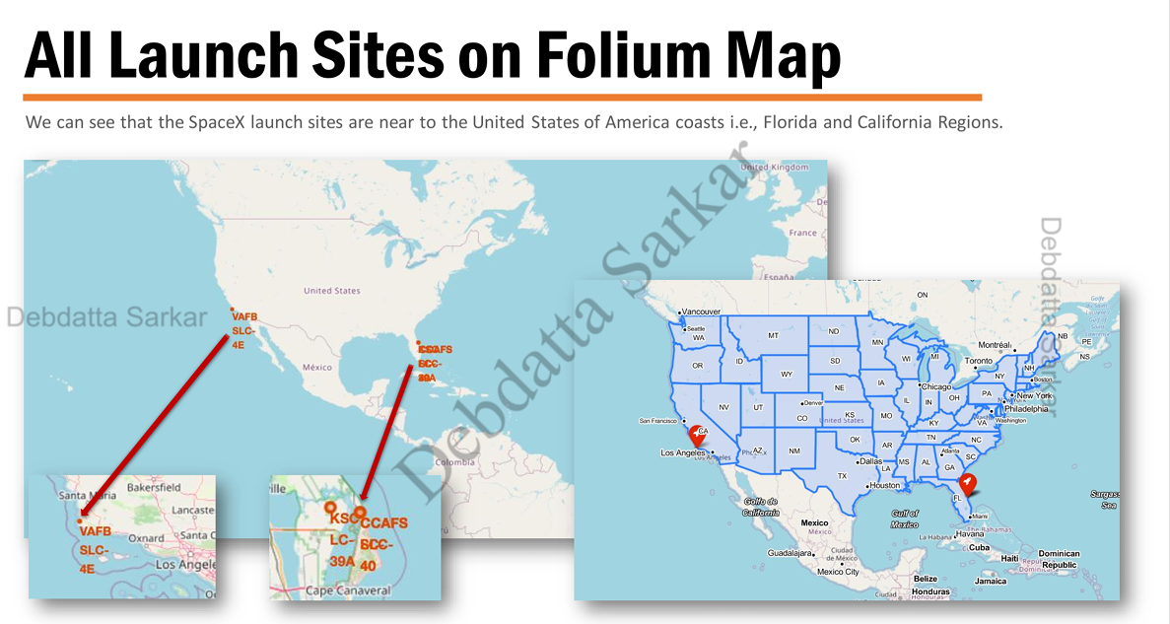
All Launch Sites on Folium Map
We can see that the SpaceX launch sites are near to the United States of America coasts i.e., Florida and California Regions.

Slide 40
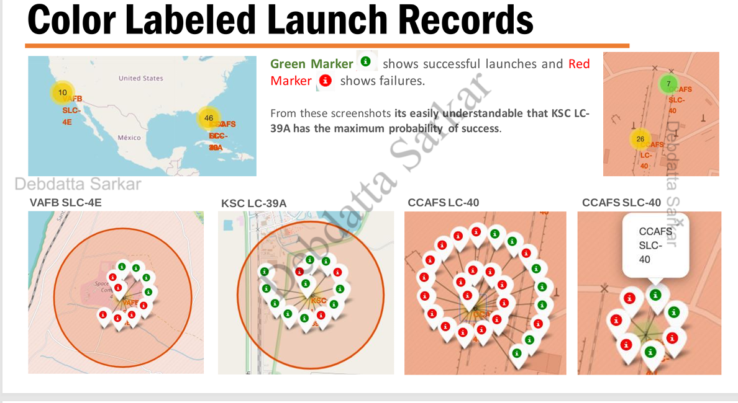
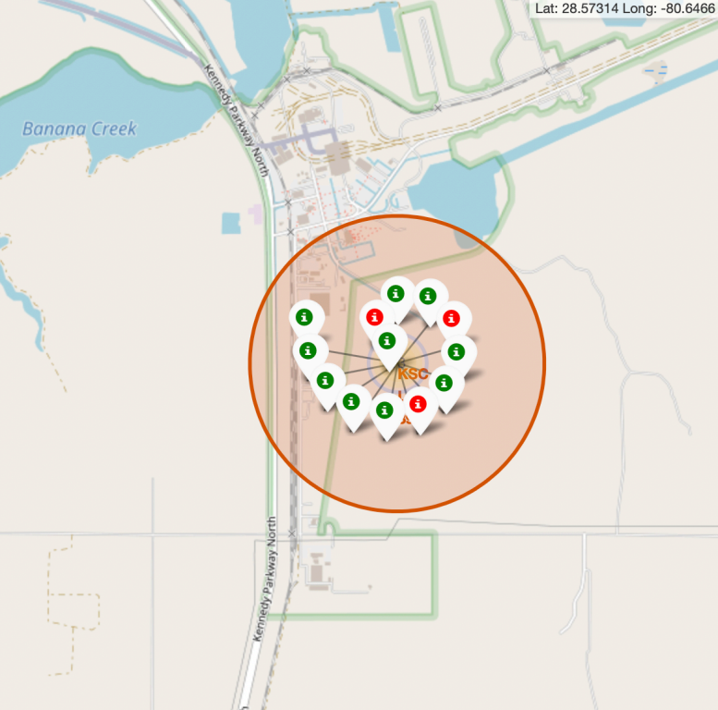

Color Labeled Launch Records
From these screenshots its easily understandable that KSC LC- 39A has the maximum probability of success.

Slide 41
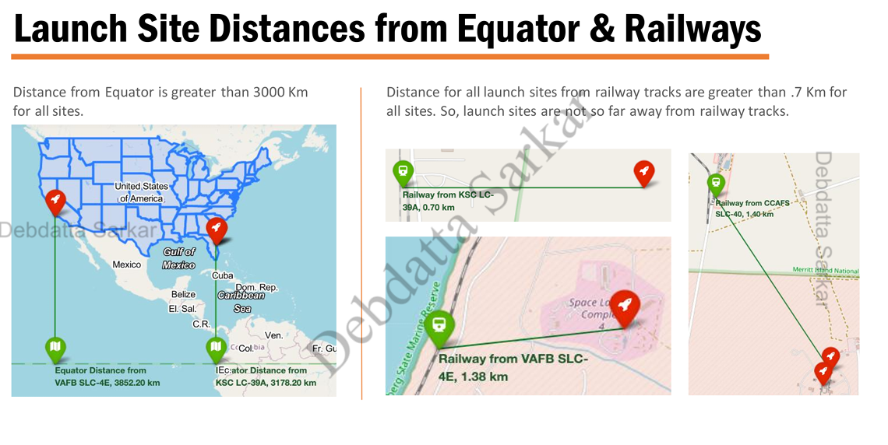
Launch Site Distances from Equator & Railways
Distance from Equator is greater than 3000 Km for all sites.
Distance for all launch sites from railway tracks are greater than .7 Km for all sites. So, launch sites are not so far away from railway tracks.

Slide 42
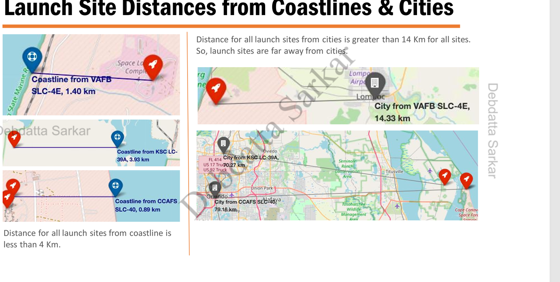
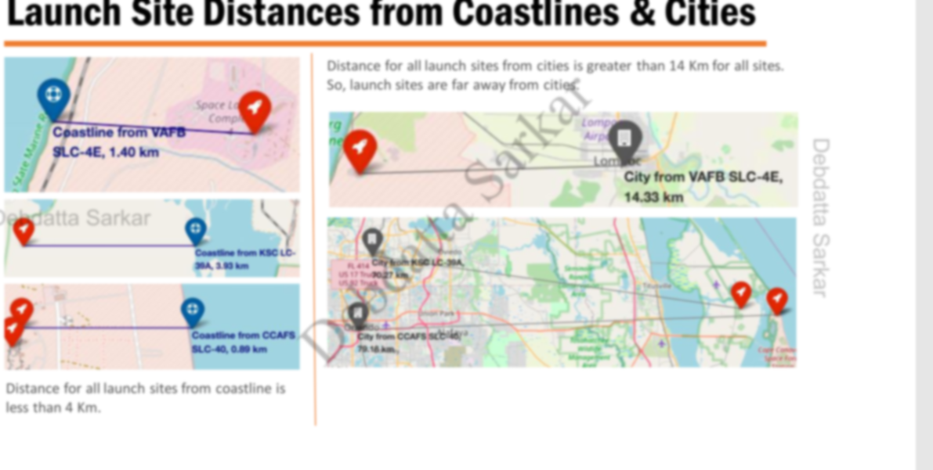
Launch Site Distances from Coastlines & Cities
Distance for all launch sites from cities is greater than 14 Km for all sites. So, launch sites are far away from cities

Slide 43
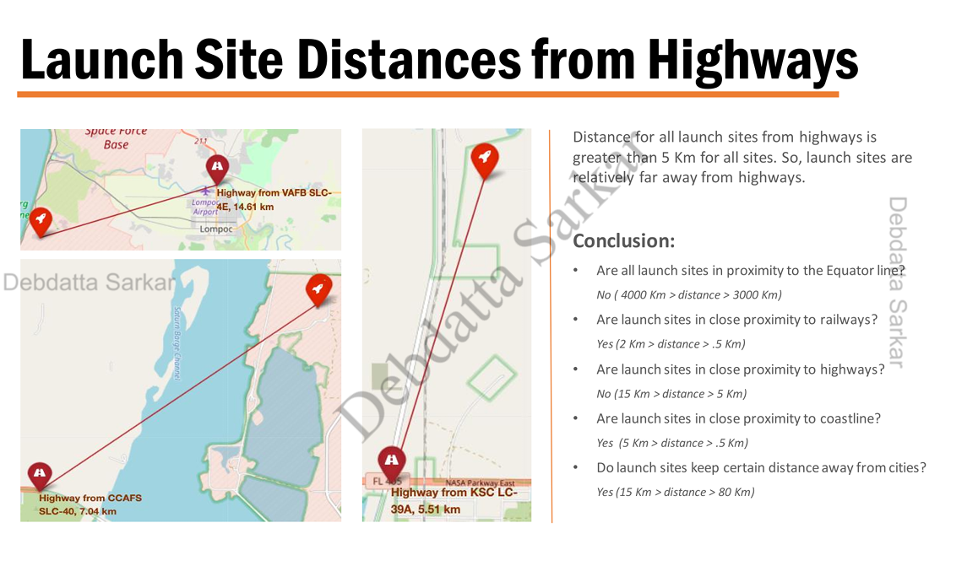
Launch Site Distances from Highways
Distance for all launch sites from highways is greater than 5 Km for all sites. So, launch sites are relatively far away from highways.
Conclusion:
Are all launch sites in proximity to the Equator line
No (4000 Km > distance > 3000 Km)
Are launch sites in close proximity to railways?
Yes (2 Km > distance > .5 Km)
Are launch sites in close proximity to highways? No (15 Km > distance > 5 Km)
Are launch sites in close proximity to coastline? Yes (5 Km > distance > .5 Km)
Do launch sites keep certain distance away from cities? Yes (15 Km > distance > 80 Km)

Slide 44

Build a Dashboard with Plotly Dash

Slide 45
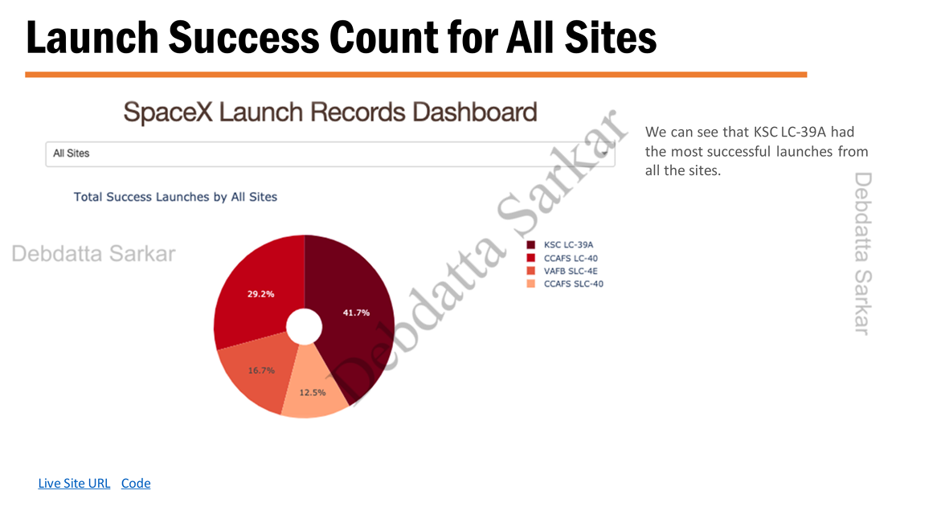

Launch Success Count for All Sites
SpaceX Launch Records Dashboard
We can see that KSC LC-39A had the most successful launches from all the sites.
All Sites
Total Success Launches by All Sites
Live Site URL Code

Slide 46
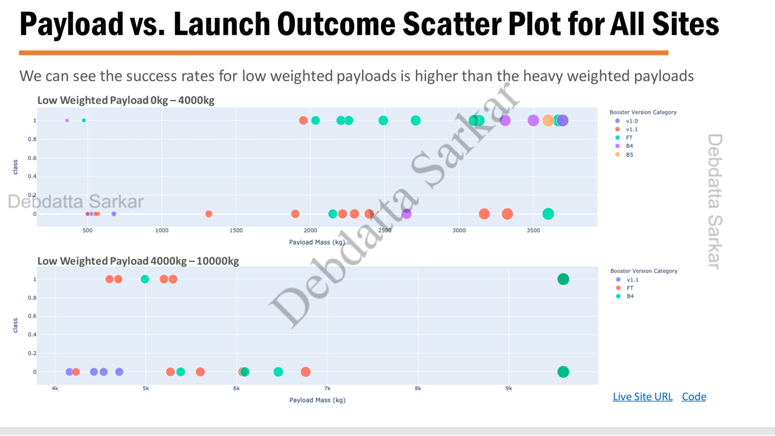
Payload vs. Launch Outcome Scatter Plot for All Sites
We can see the success rates for low weighted payloads is higher than the heavy weighted payloads
Low Weighted Payload 0kg-4000kg
Low Weighted Payload 4000kg-10000kg

Slide 47
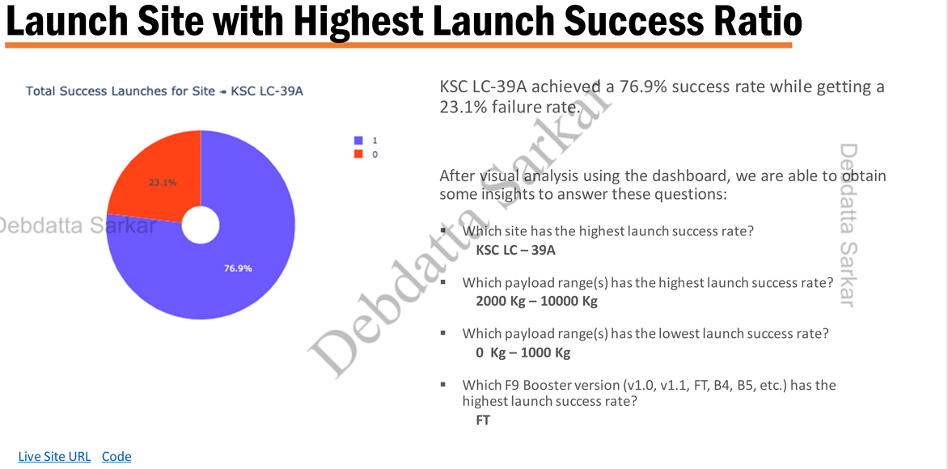
Launch Site with Highest Launch Success Ratio
Total Success Launches for Site KSC LC-39A
KSC LC-39A achieved a 76.9% success rate while while getting a 23.1% failure rate
After using the dashboard, we are able to obtain sone insight to answer these questions:
Which site has the highest launch success rate?
KSC LC-39A
Which payload range(s) has the highest launch success rate?
2000 Kg-10000 Kg 1 0
Which payload range(s) has the lowest launch success rate?
0 Kg-1000 Kg
Which F9 Booster version (v1.0, v1.1, FT, B4, B5, etc.) has the highest launch success rate?
FA
Live Site URL Code

Slide 48

Predictive analysis (Classification)

Slide 49
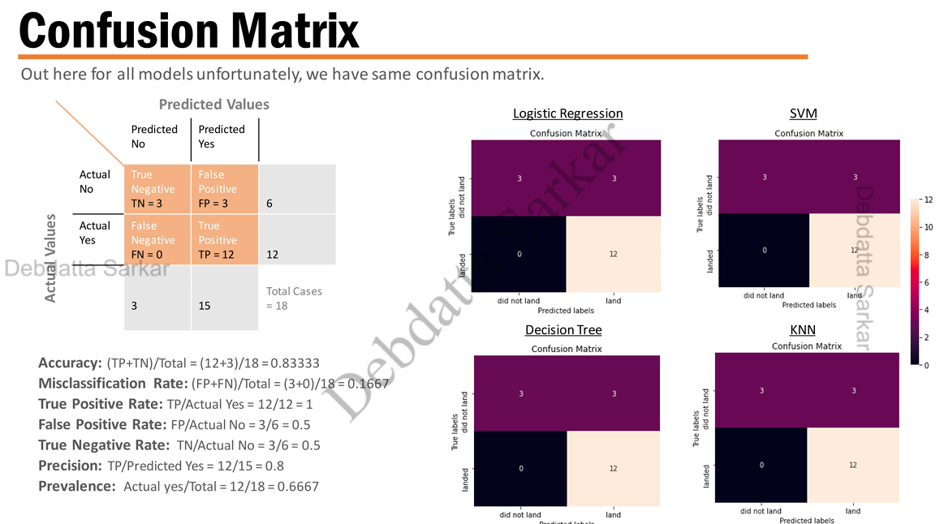
Confusion Matrix
Actual Values
Out here for all models unfortunately, we have same confusion matrix.
Logistic Regression
SVM
Decision Tree
KNN
Accuracy: (TP+TN)/Total = (12 + 3) / 18 = 0.83333
Misclassification Rate: (FP+FN)/Total
= (3 + 0) / 18 = 0.1667 True Positive Rate: TP/Actual Yes = 12/12 = 1
False Positive Rate: FP/Actual No = 3/6 = 0.5
True Negative Rate: TN/Actual No = 3/6 = 0.5
Precision: TP/Predicted Yes = 12/15=0.8
Prevalence: Actual yes/Total = 12/18=0.6667

Slide 50
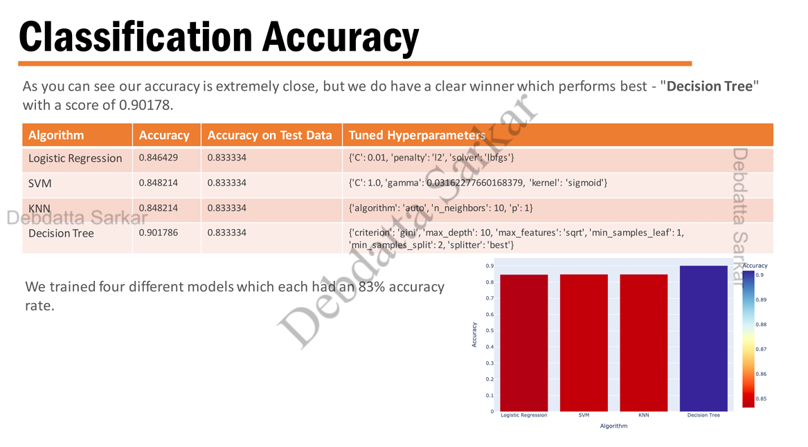
Classification Accuracy
As you can see our accuracy is extremely close, but we do have a clear winner which performs best - "Decision Tree" with a score of 0.90178.
Algorithm | Accuracy | Accuracy on Test Data | Tuned Hyperparameters erparameters
Logistic Regression | 0.846429 | 0.833334 | ('C': 0.01, 'penalty':'12', 'solver "Ibfgs')
SVM | 0.848214 | 0.833334 | ('C': 1.0, 'gamma': 0.03162277660168379, 'kernel': 'sigmoid')
KNN | 0.848214 | 0.833334 | ['algorithm': 'auto', 'n_neighbors': 10, 'p': 1)
Decision Tree | 0.901786 | 0.833334 | ('criterion': 'gini', 'max_depth': 10, 'max_features': 'sqrt', 'min_samples_leaf: 1, 'min_samples_split': 2, 'splitter': 'best')
We trained four different models which each had rate an 83% accuracy

Slide 51
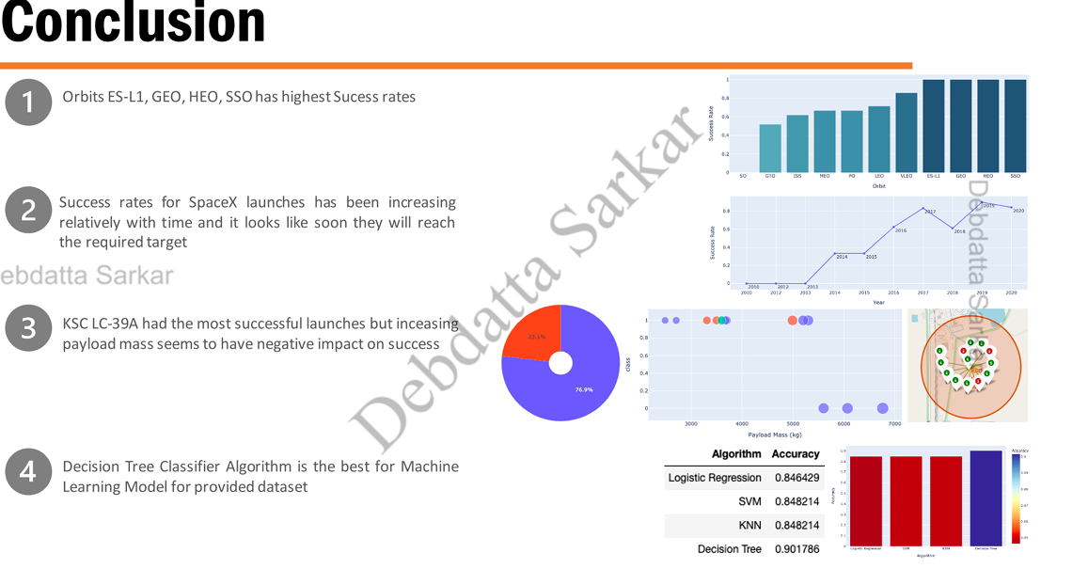


Conclusion
Orbits ES-L1, GEO, HEO, SSO has highest Sucess rates
Success rates for SpaceX launches has been increasing relatively with time and it looks like soon they will reach the required target
KSC LC-39A had the most successful launches but increasing payload mass seems to have negative impact on success
Decision Tree Classifier Algorithm is the best for Machine Learning Model for provided dataset

Slide 52

Appendix
Interactive Plotly
Folium MeasureControl Plugin Tool
Folium Custom Title Layers with Labels
IBM Cognos Visualization Tool
Basic Decision Tree Construction

Slide 53
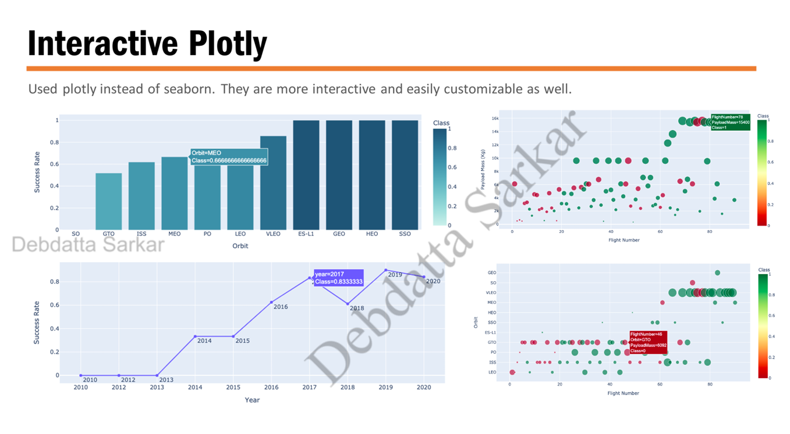

Interactive Plotly
Used plotly instead of seaborn. They are more interactive and easily customizable as well.

Slide 54
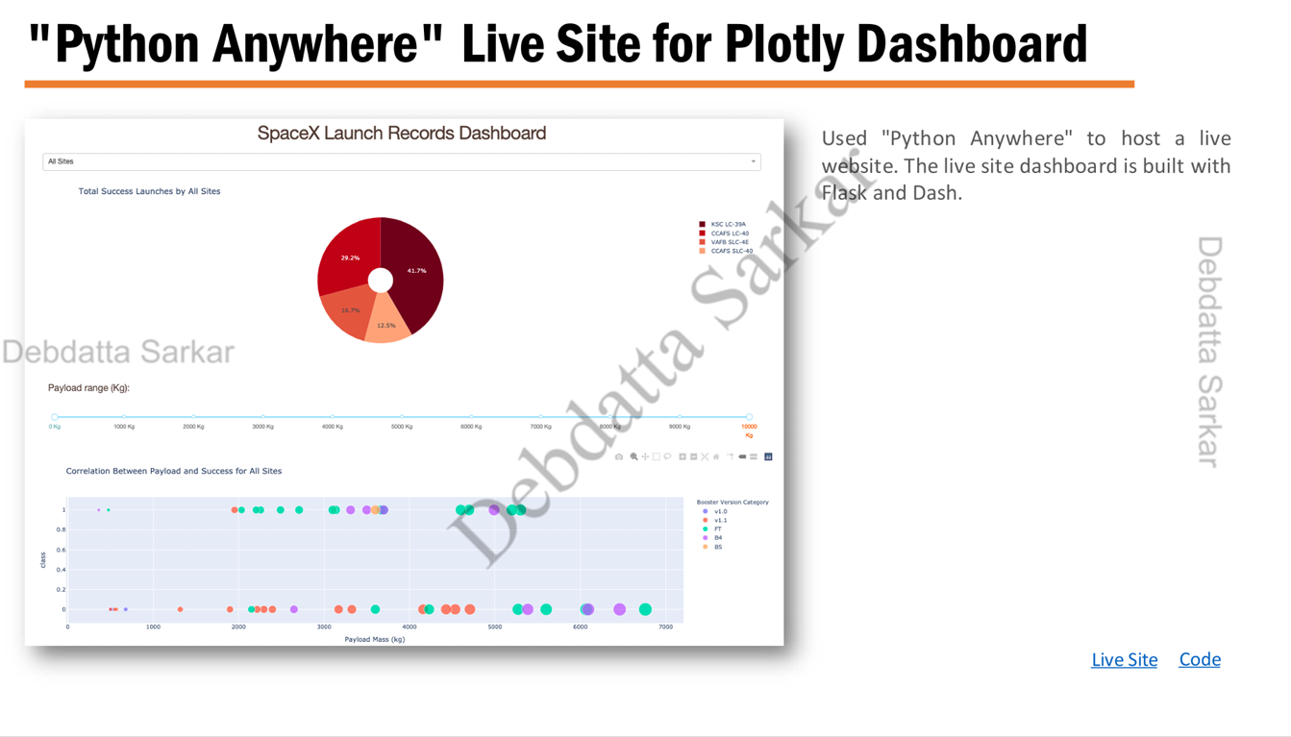






"Python Anywhere" Live Site for Plotly Dashboard
Used "Python Anywhere" to host a live website. The The live site dashboard is built with Flask and Dash.
Payload range (Kgl):
Live Site
Code

Slide 55
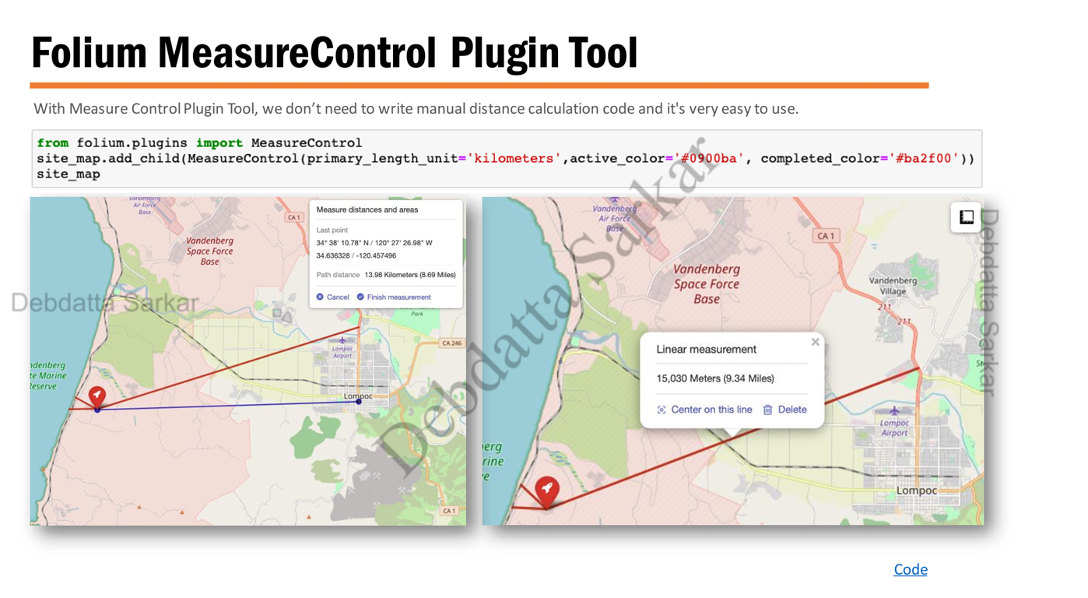
Folium MeasureControl Plugin Tool
With Measure Control Plugin Tool, we don't need to write manual distance calculation code and it's very easy to use.
from folium.plugins import MeasureControl
site_map.add_child(MeasureControl (primary_length_unit='kilometers', active_color='#0900ba", completed_color='#ba2f00')) site_map

Slide 56
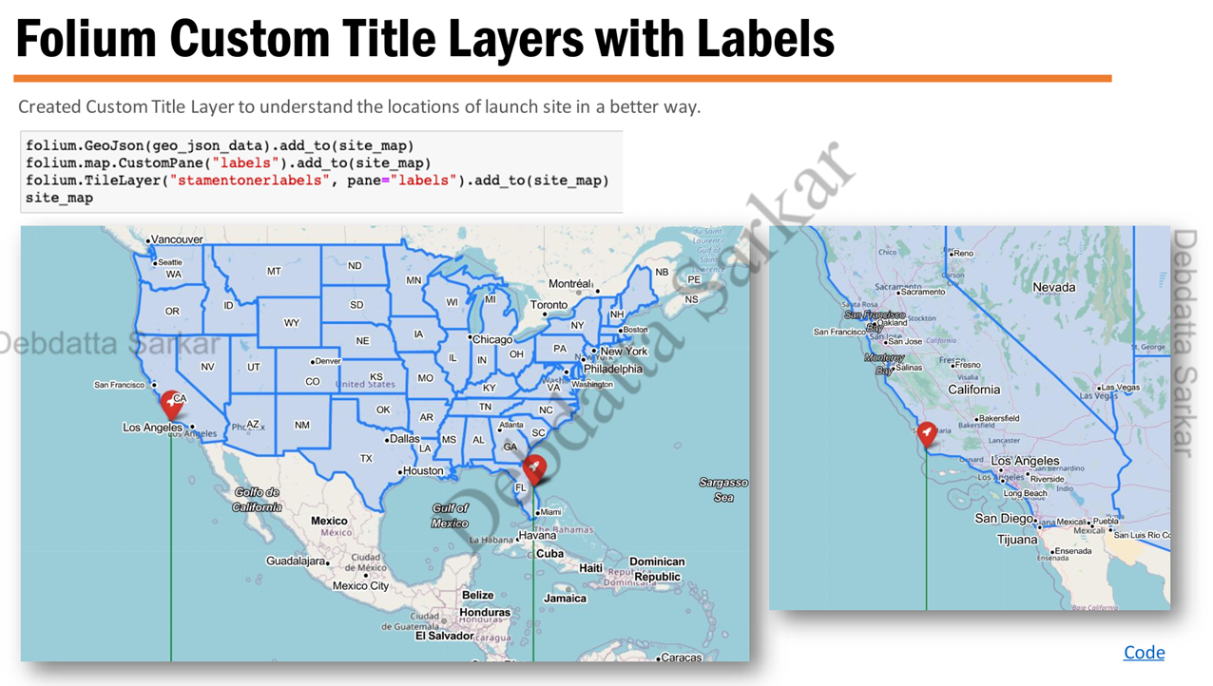
Folium Custom Title Layers with Labels
Created Custom Title Layer to understand the locations of launch site in a better way
folium.GeoJson(geo_json_data).add_to(site_map)
folium.map.CustomPane("labels").add_to(site_map)
folium. TileLayer("stamentonerlabels", pane="labels").add_to(site_map)
site_map

Slide 57
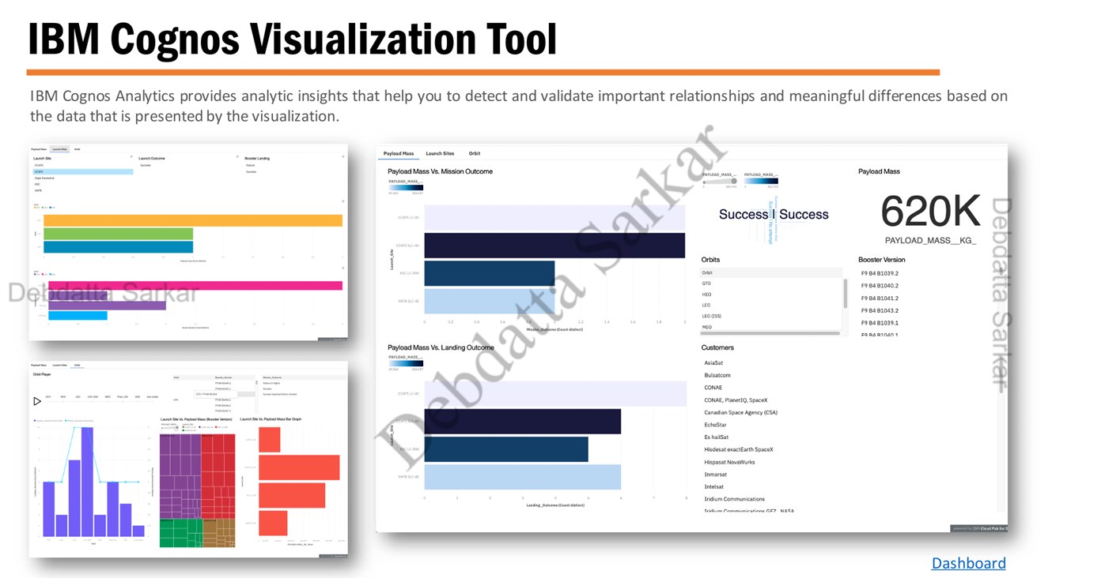





IBM Cognos Visualization Tool
IBM Cognos Analytics provides analytic insights that help you to detect and validate important relationships and meaningful differences based on the data that is presented by the visualization.
620K
PAYLOAD_MASS_KG
Orbit
GTO
HED
LEO
LEO (ISS)
MEO
Booster Version
F9 84 81039.2
F9 84 81040.2
F9 B4 81041.2
F9 84 81043.2
F9 84 81039.1
FORA A104 1
Customers
AsiaSat
Bulsatcom
CONAE
CONAE, Planet10, SpaceX
Canadian Space Agency (CSA)
EchoStar
Es hailSat
Hisdesat exactEarth SpaceX
Hispasat NovaWurks Inmarsat Intelsat Iridium Communications Trifum Communistinne OF MASA

Slide 58
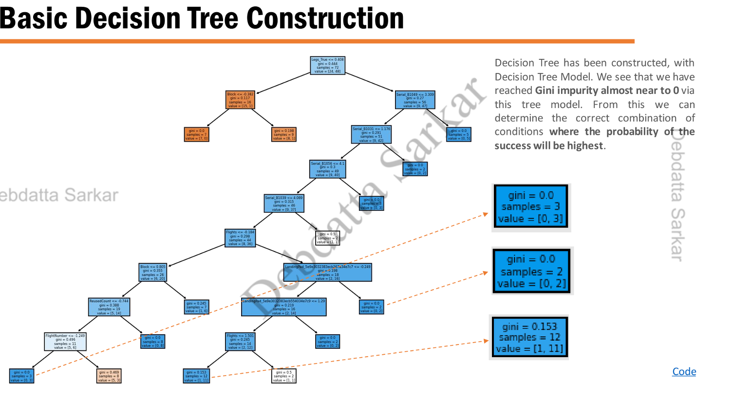





Basic Decision Tree Construction
Decision Tree has been constructed, with Decision Tree Model. We see that we have reached Gini impurity almost near to 0 via this tree model. From this we can determine the correct combination of conditions where the probability of the success will be highest.
Code

Slide 59
THANK YOU

